Slide 1

BACHELOR OF SCIENCE IN MATHEMATICS
CHRIST COLLEGE OF ARTS AND SCIENCE
DEPARTMENT OF MATHEMATICS

Slide 2
INDIAN AGRICULTURAL CROP PRODUCTION ANALYSIS (1997-2021)
Submitted by
1.Rubasree R 222108728
2.Samundeeswari K 222108729
3.Robin Raj R 222108722
4.Rajpriyan D 222108721
Guided by
Mrs.A.PushpalathaM.sc.,M.Phil.,B.Ed
Assistant Professor

Slide 3
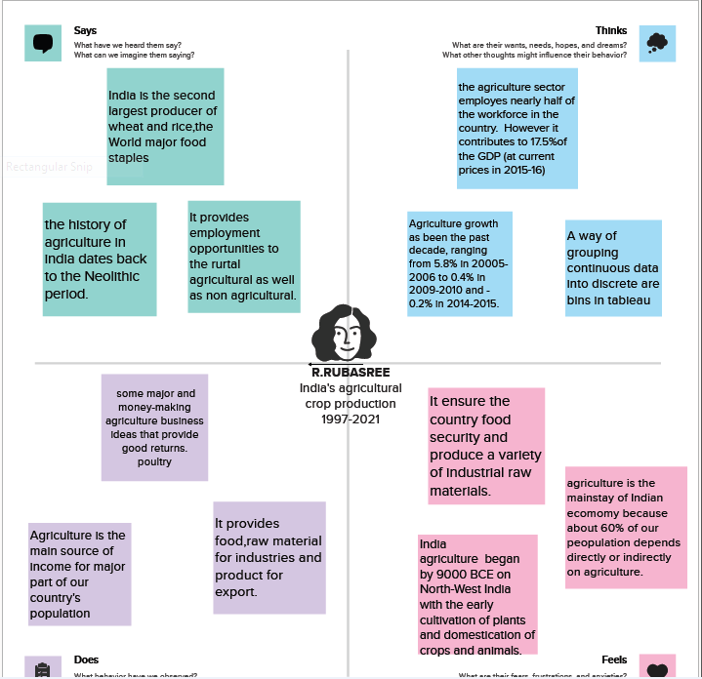
EMPATHY MAP

Slide 4
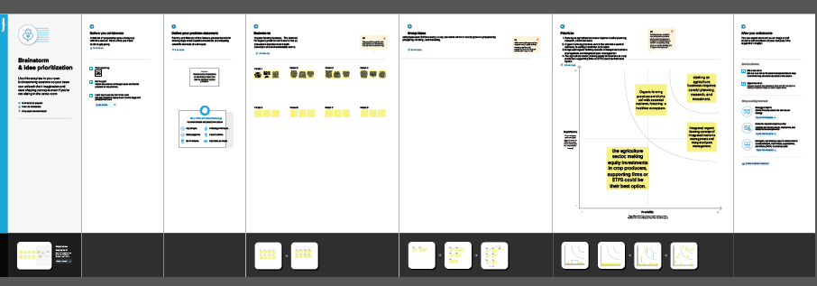
BRAIN STORMING

Slide 5
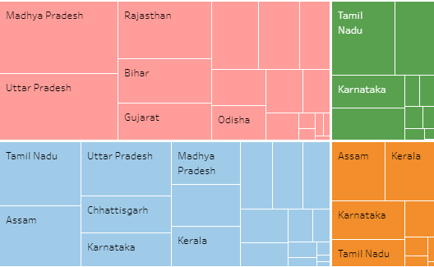

Slide 6
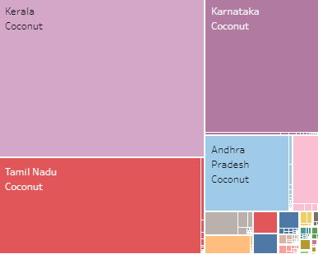

Slide 7
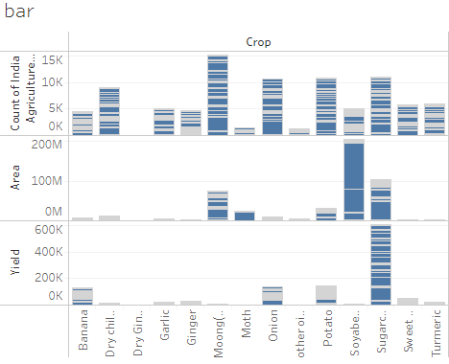

Slide 8
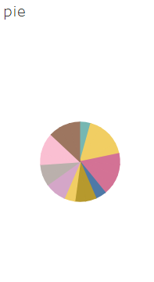

Slide 9
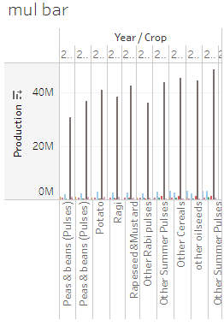

Slide 10
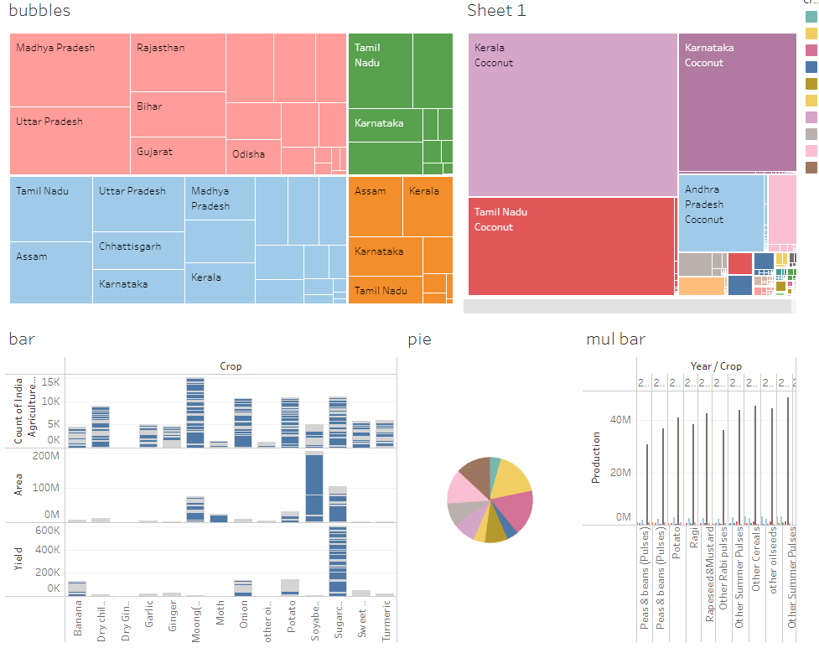

Slide 12
THANKYOU

